Slide 1
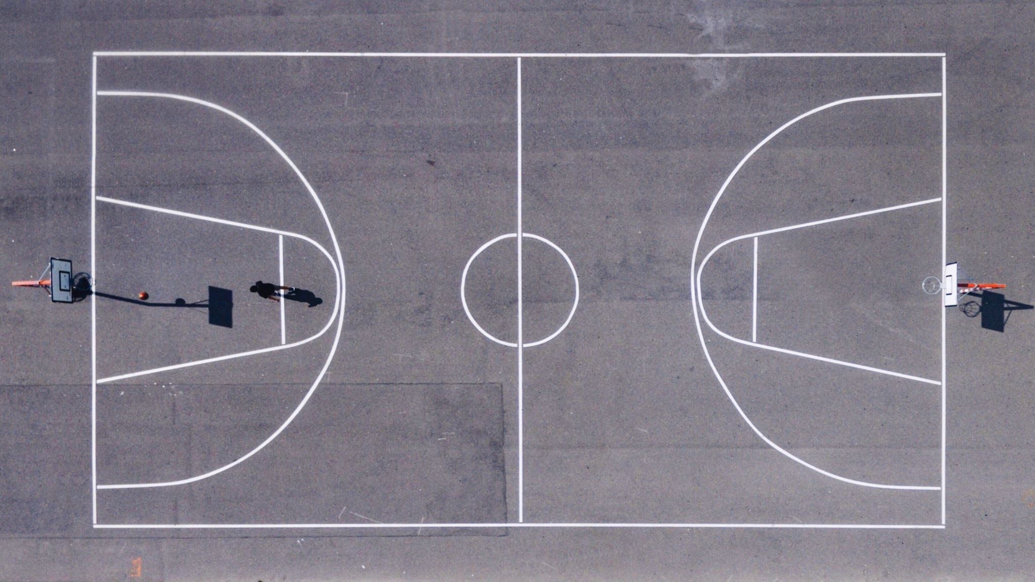
NBA Points Predictor
By: Jaime Castaneda

Slide 2

Data Exploration
Histogram
Scatterplots
Boxplots
Correlation Values

Slide 3
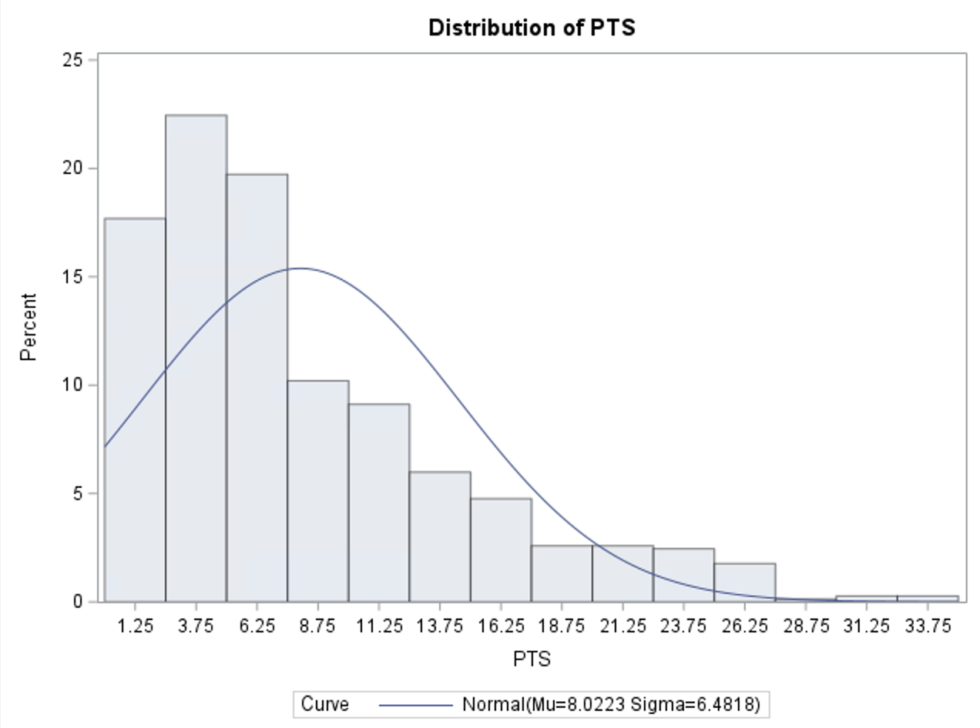
Histogram
Skewness
Outliers

Slide 4
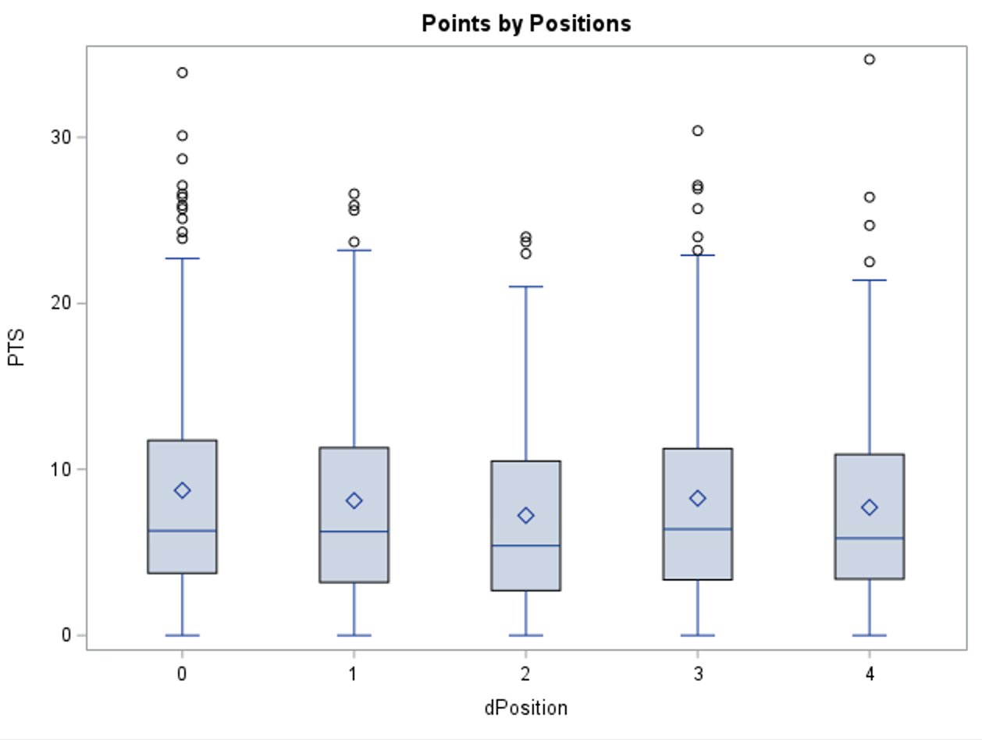
Scatterplot
Skewness
Outliers

Slide 5
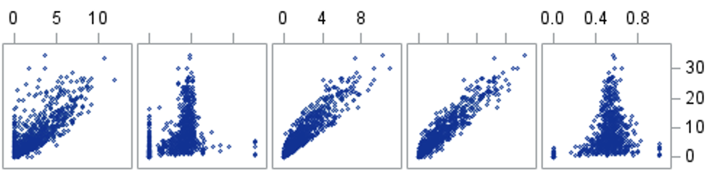
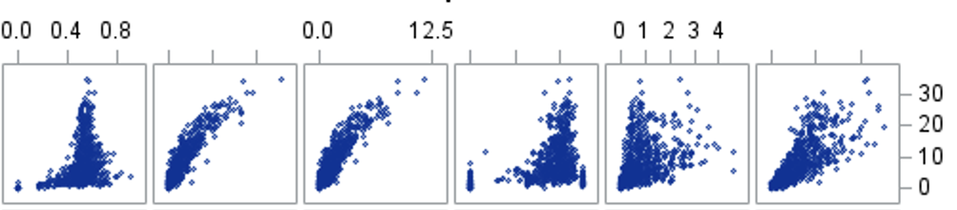
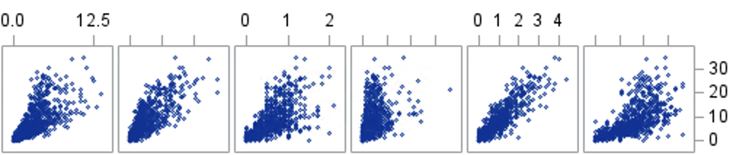
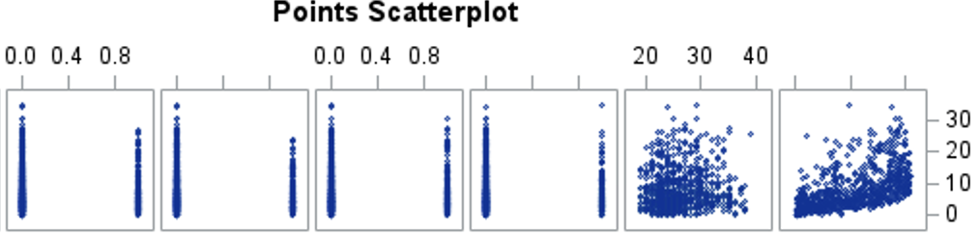
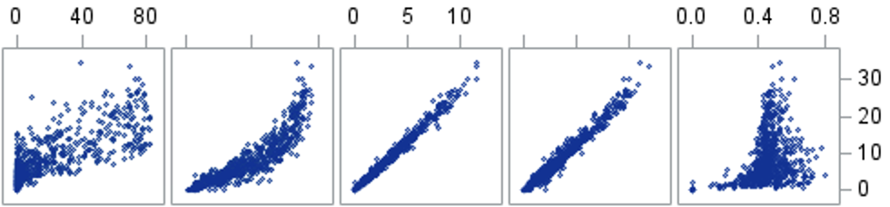
Scatterplot
Linearity
Curves/polynomial

Slide 6
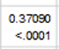
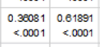
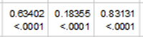
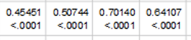
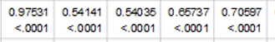
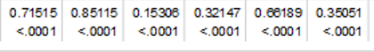
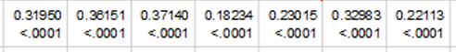
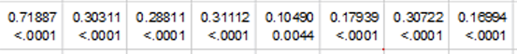

Slide 7
Analysis Stage
Assumptions and Diagnostics
Residuals
Normality Plot
Outliers and Influential Points
Multicollinearity

Slide 8
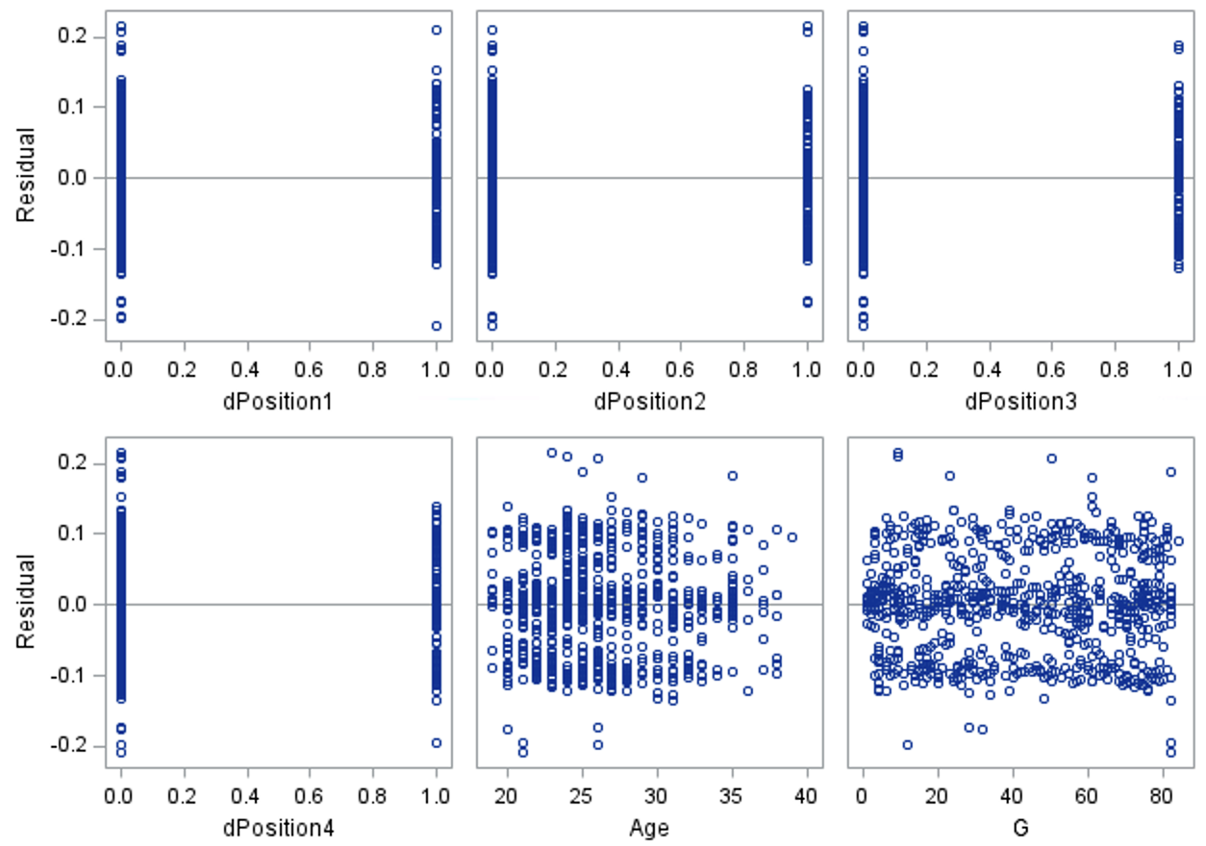
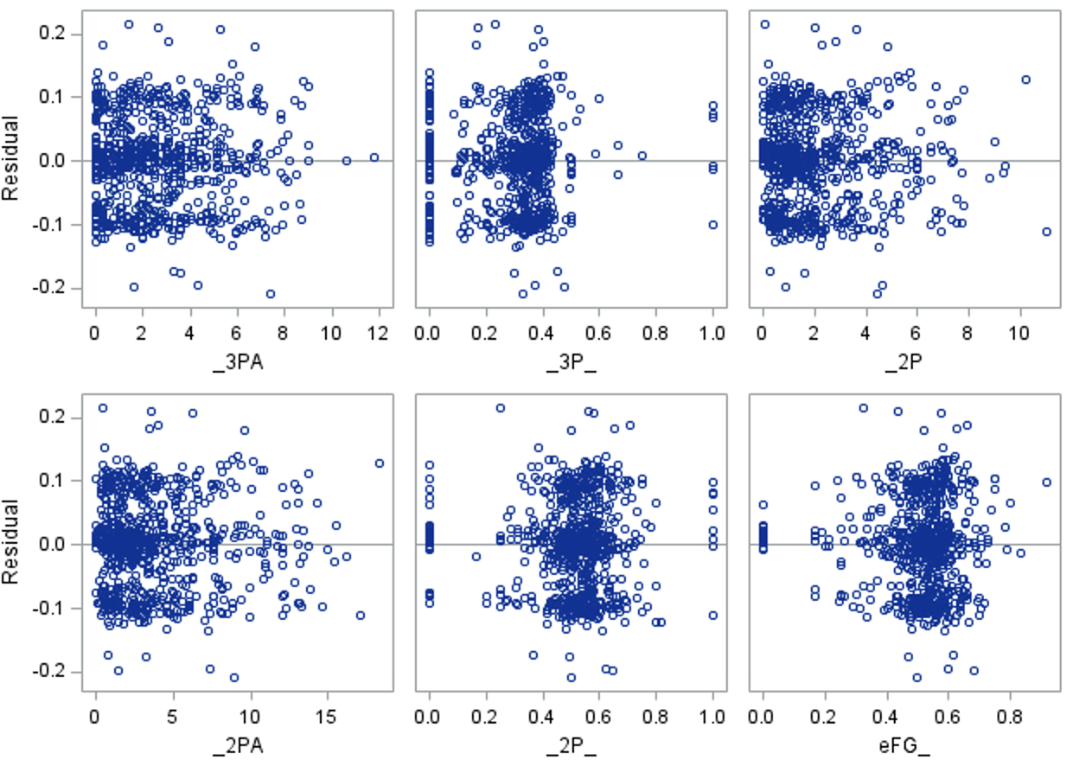
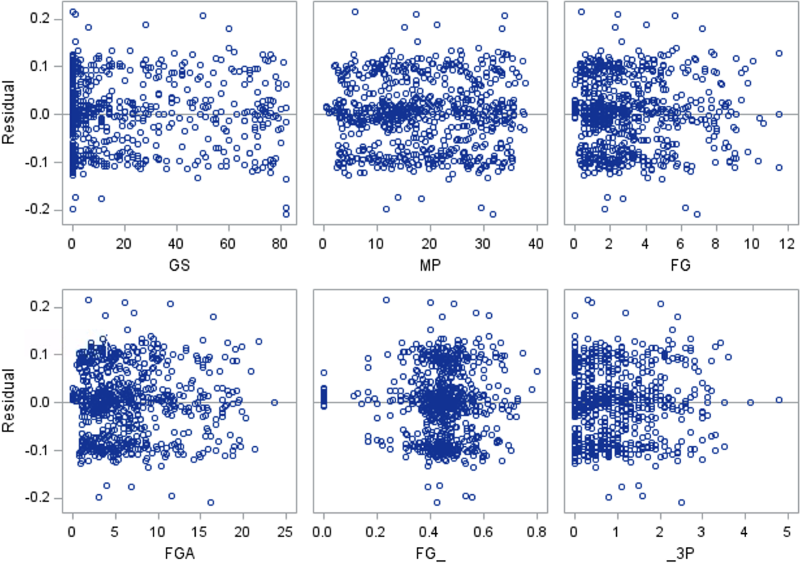
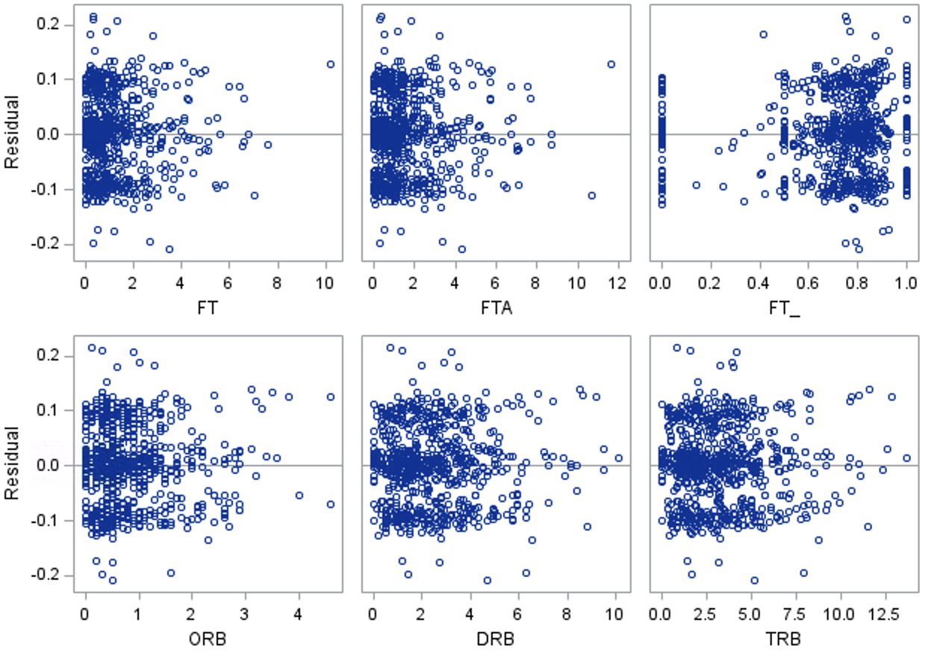
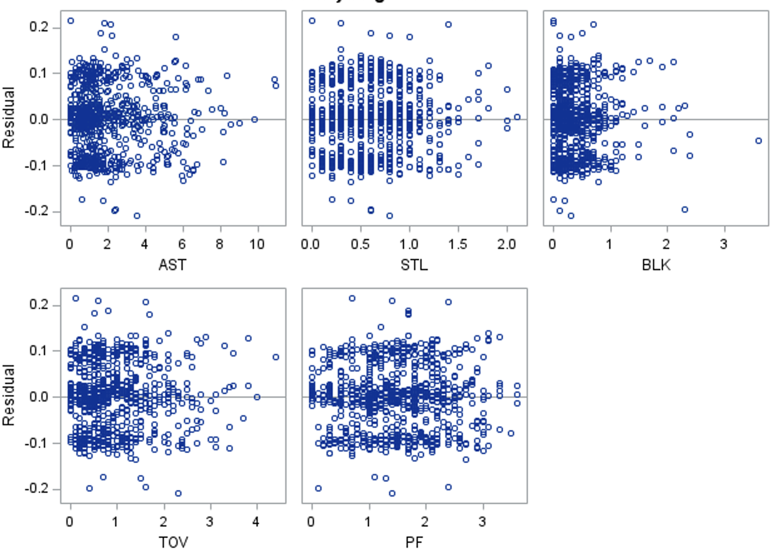
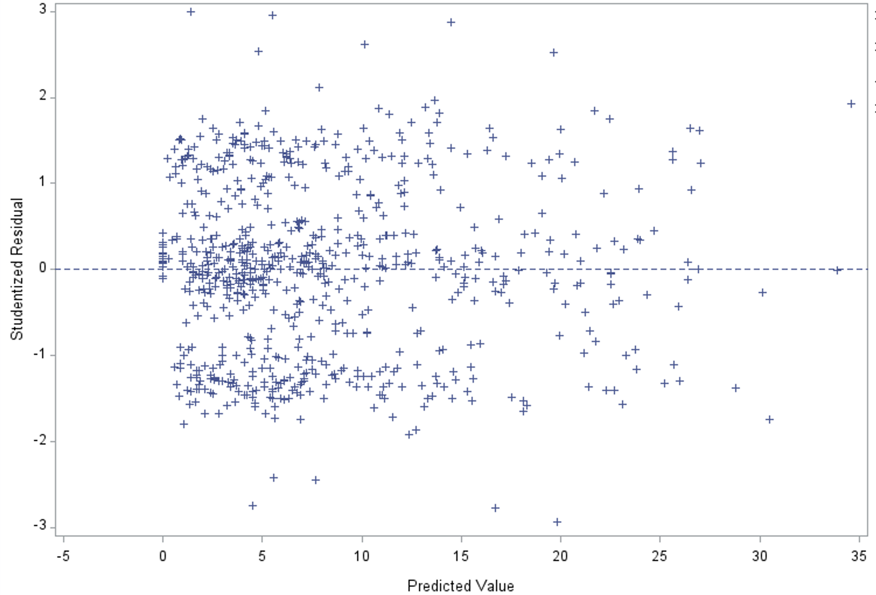

Slide 9
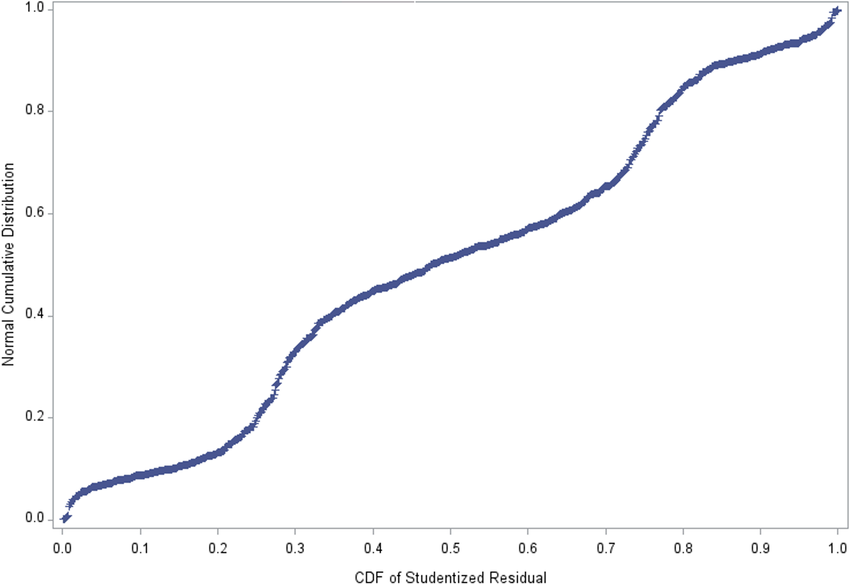
Assumptions and Diagnostics
Residuals vs x-variables
Residuals vs Predicted
Normality Plot

Slide 10

Transformation is needed
Log transformation

Slide 11
Data Exploration
Histogram
Scatterplots
Boxplots
Correlation Values

Slide 12
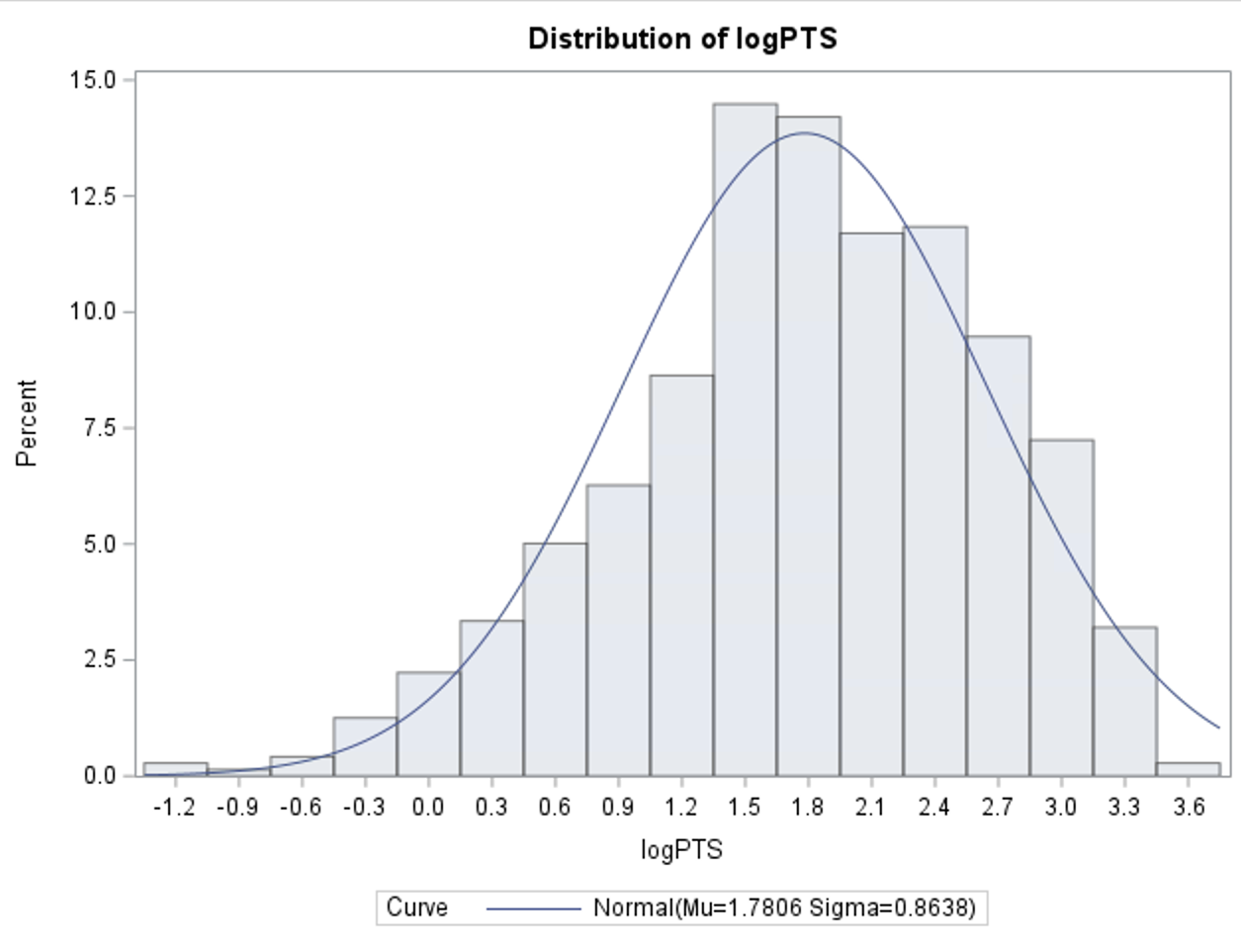
Histogram
Skewness
Outliers

Slide 13
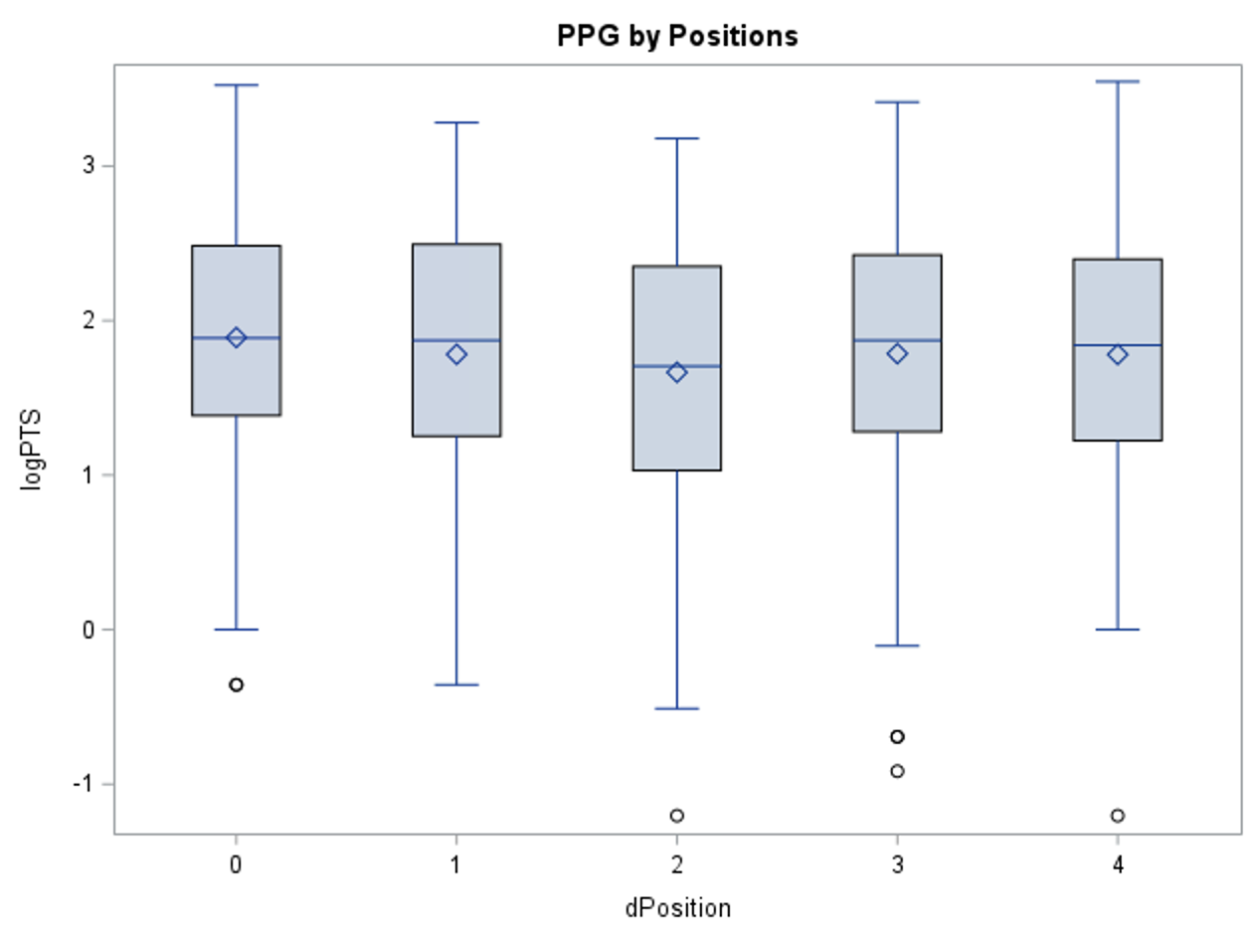
Boxplot
Skewness
Outliers

Slide 14
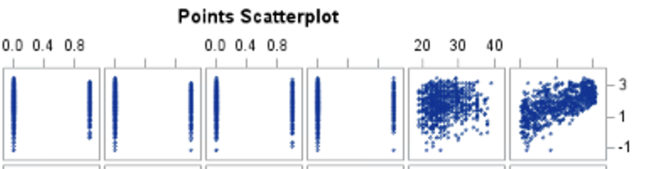
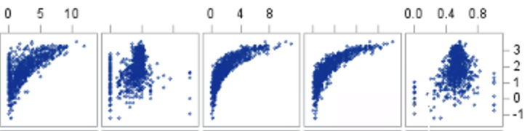
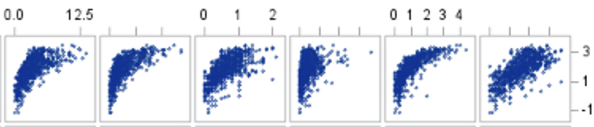
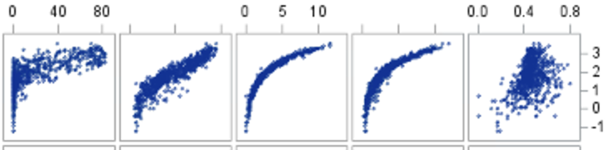
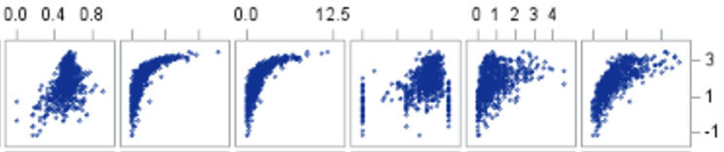

Slide 15
Scatterplot
Linearity
Correlation

Slide 16
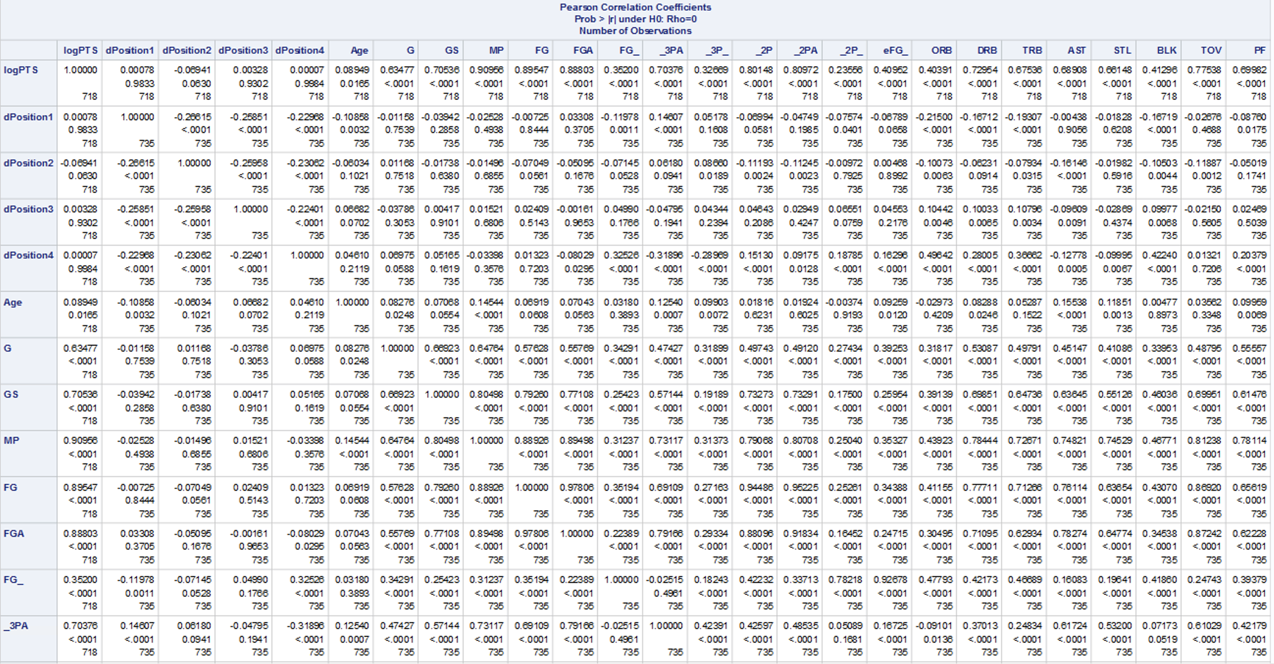
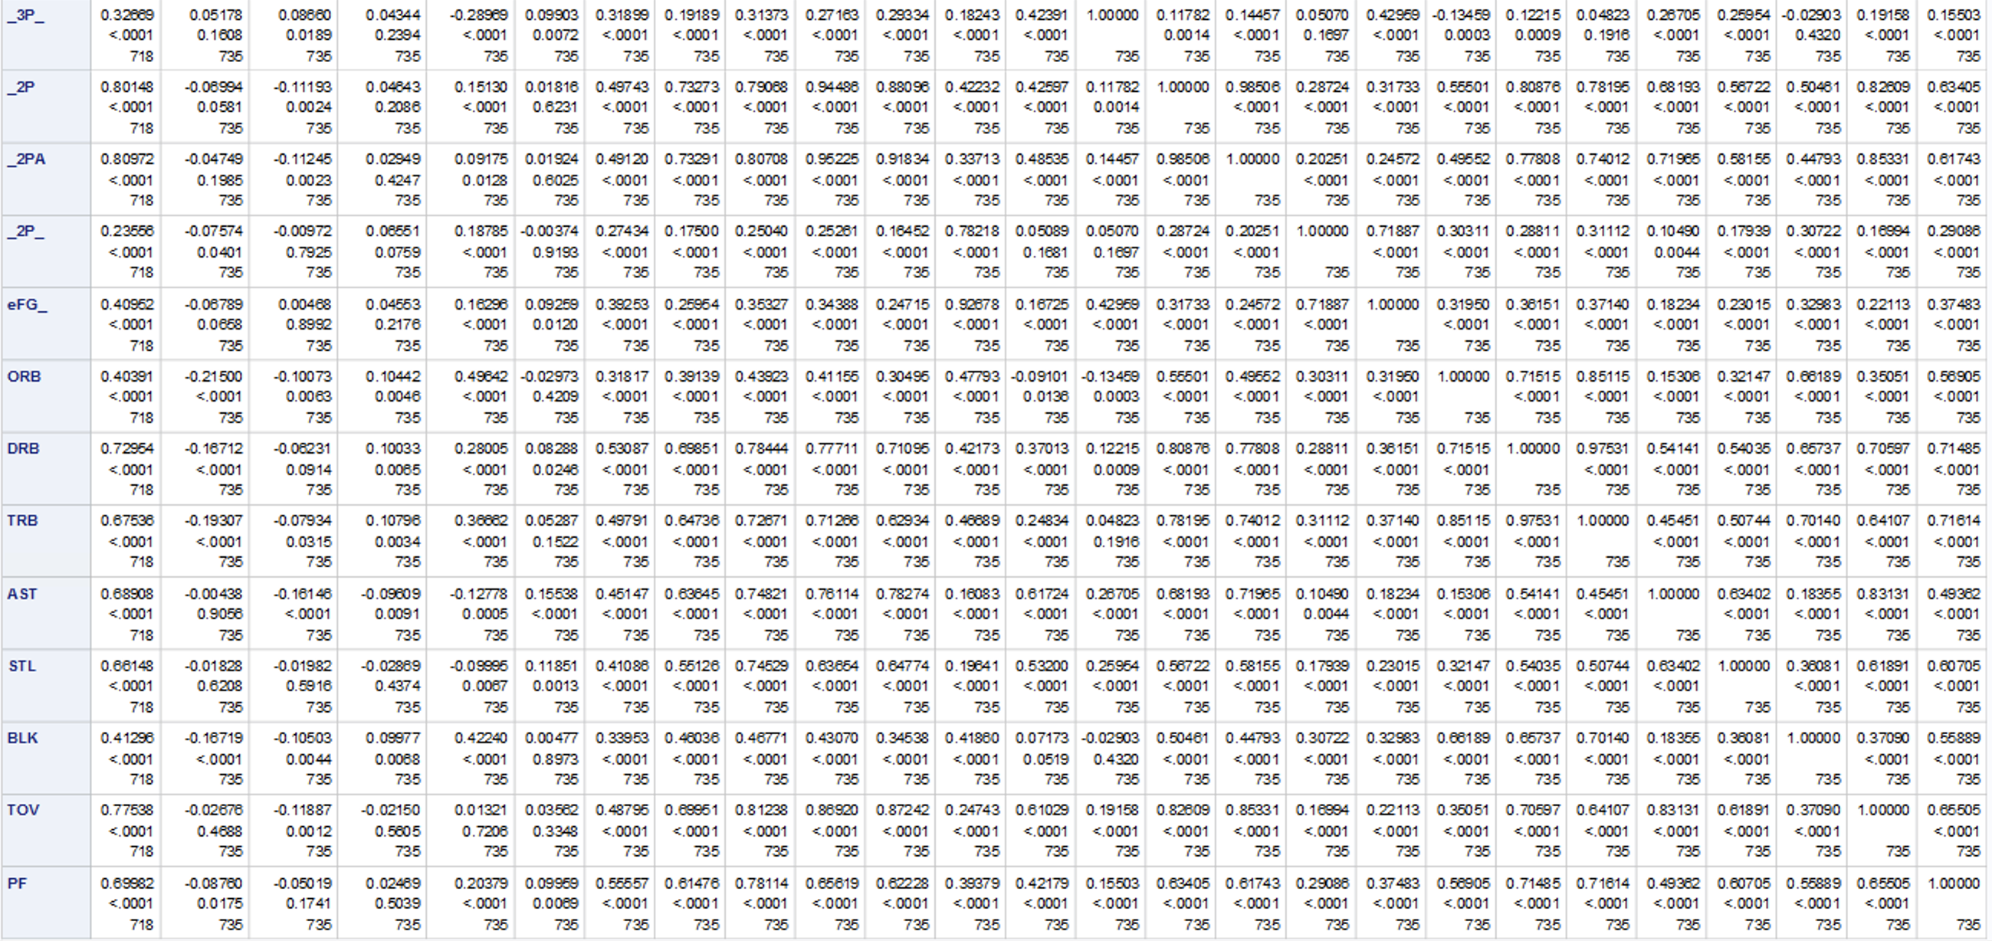
Correlation Values
Many values are related

Slide 17
Analysis Stage
Assumptions and Diagnostics
Residuals
Normality Plot
Outliers and Influential Points
Multicollinearity

Slide 18
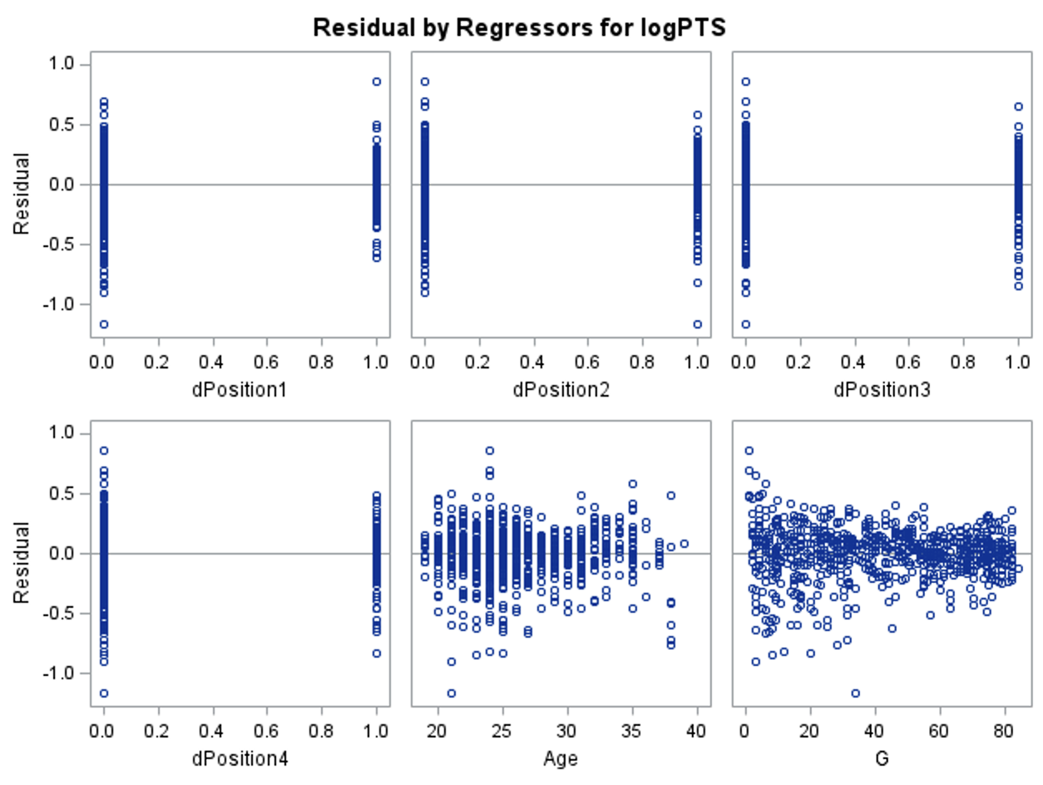
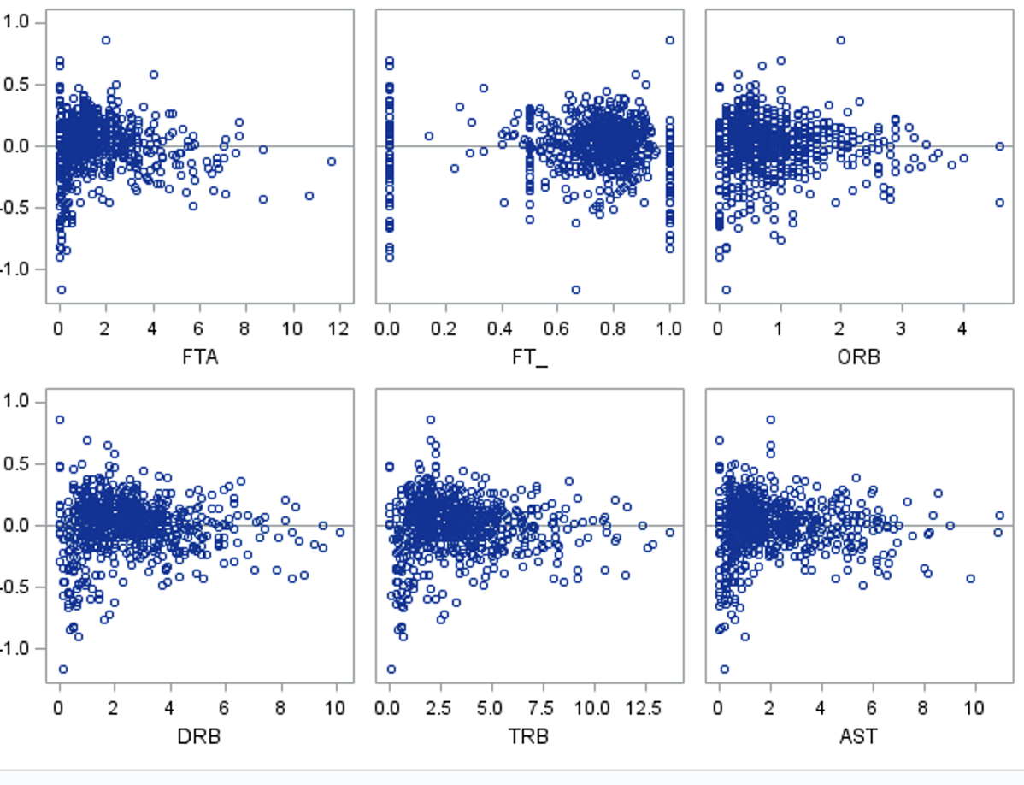
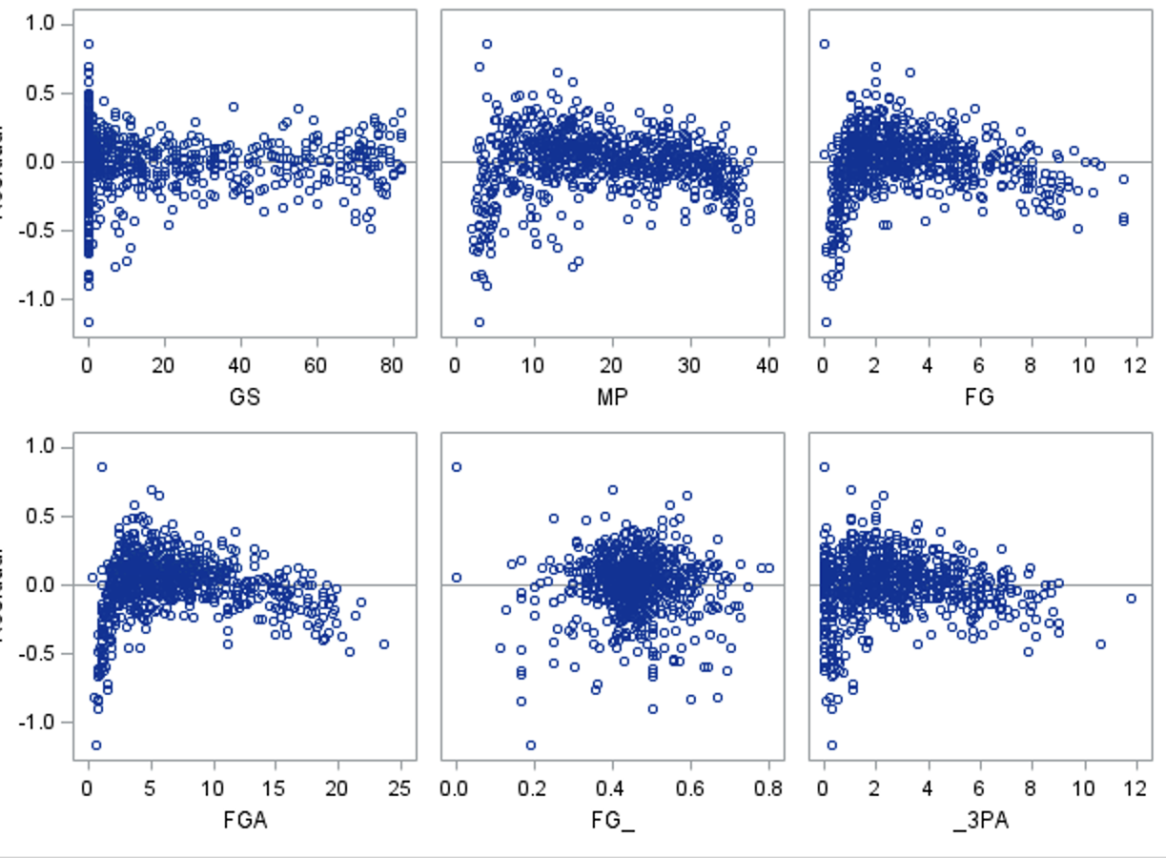
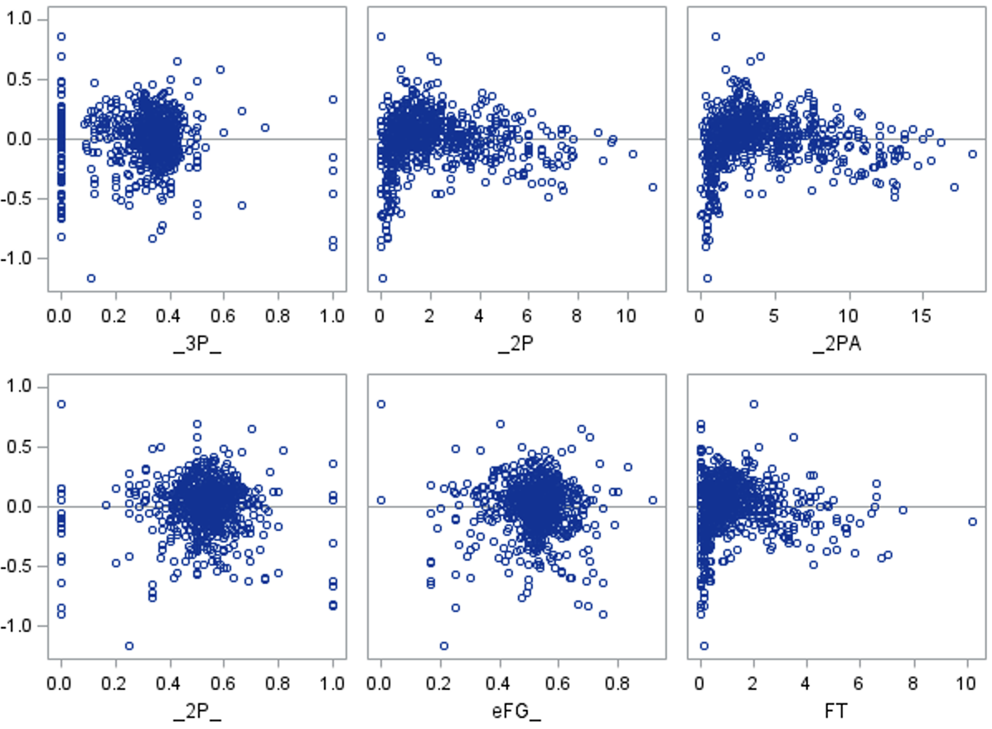
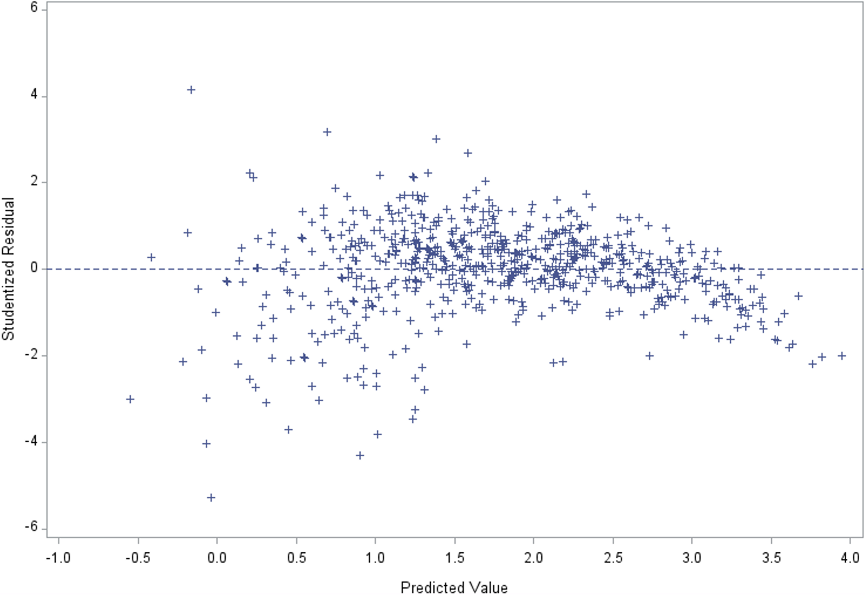
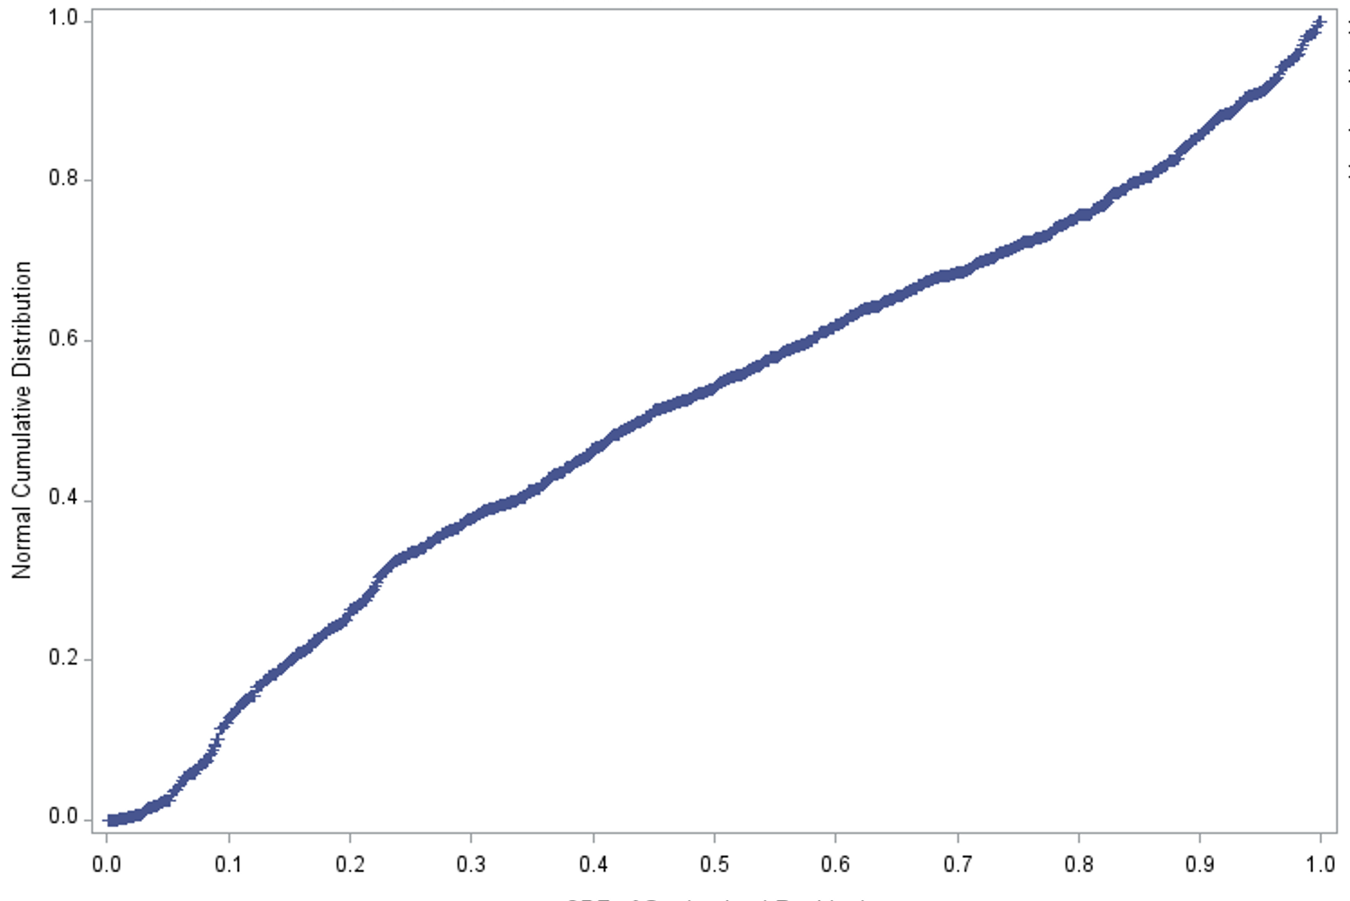

Slide 19
Assumptions
Residuals vs x-variables
Residuals vs Predicted
Normality Plot

Slide 20
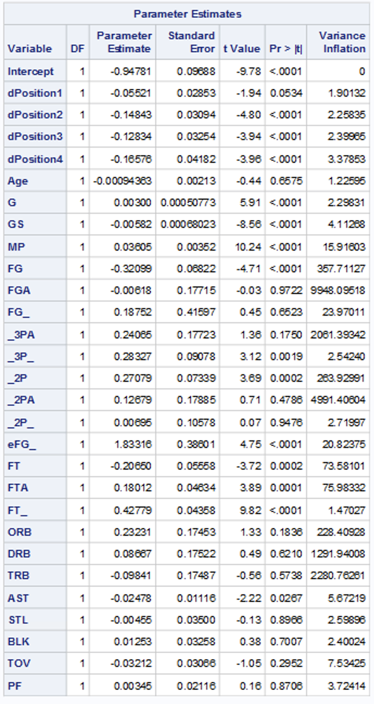
Diagnostics
Multicollinearity
Many values will relate to each other
Many values will be deleted

Slide 21
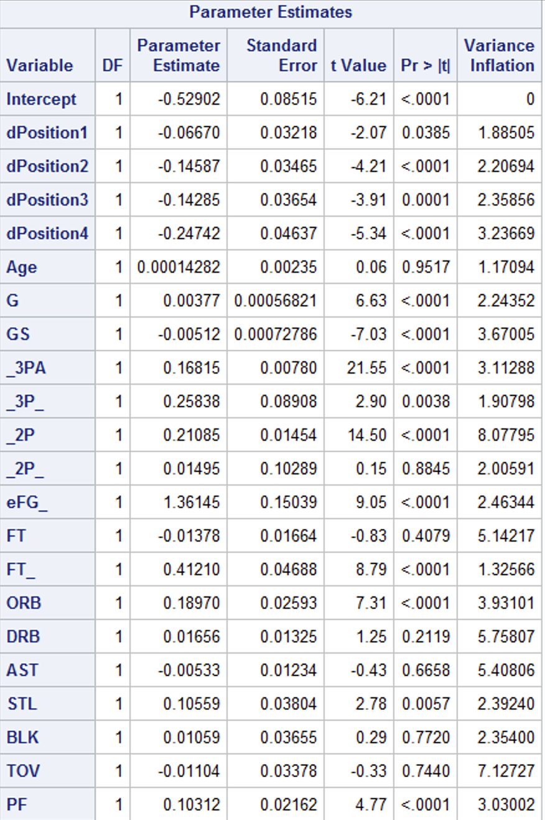
Diagnostics
Multicollinearity
X-variables remaining after removing for multicollinearity

Slide 22
Outliers and Influential Points
Good amount
Need to be removed

Slide 23
Validation/Testing
Splitting the data
Model selection
Final-final Model

Slide 24

Splitting the data
75/25 Split
Notes:
Why? Because I felt like I had enough values in the training where I didn’t have to worry about doing an 80/20 split.

Slide 25
Model Selection
Capability Potential, CP
Final Equation
Performance
Assumptions and Diagnostics
Backward
Final Equation
Performance
Assumptions and Diagnostics
Final-final Model

Slide 26
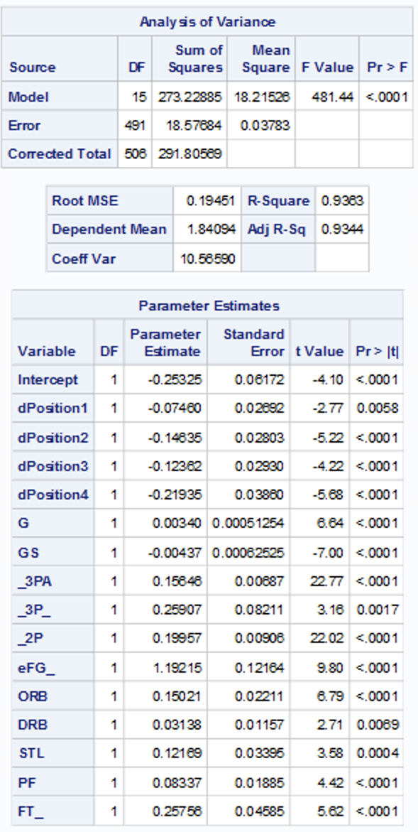
Capability Potential, CP
Final Equation
logPTS = -0.2533 – 0.0746 dPosition1 – 0.1464 dPosition2 – 0.1236 dPosition3 – 0.2194 dPosition4 + 0.0034 G – 0.0044 GS + 0.1565 3PA + 0.2591 3P% + 0.1996 2P + 1.1922 eFG% + 0.1502 ORB + 0.0314 DRB + 0.1217 STL + 0.0834 PF + 0.2576 FT%

Slide 27
Capability Potential, CP
Interpreting the final equation
dPosition1: logPTS will decrease 7.1885% if this goes up by one
dPosition2: logPTS will decrease 13.6188% if this goes up by one
dPosition3: logPTS will decrease 11.6267% if this goes up by one
dPosition4: logPTS will decrease 19.7000% if this goes up by one
G: logPTS will increase 0.3406% if this goes up by one
GS: logPTS will decrease 0.4390% if this goes up by one
3PA: logPTS will increase 16.9411% if this goes up by one
3P%: logPTS will increase 29.5763% if this goes up by one
2P: logPTS will increase 22.0914% if this goes up by one
eFG%: logPTS will increase 229.4320% if this goes up by one
ORB: logPTS will increase 16.2067% if this goes up by one
DRB: logPTS will increase 3.1898% if this goes up by one
STL: logPTS will increase 12.9415% if this goes up by one
PF: logPTS will increase 8.6977% if this goes up by one
FT%: logPTS will increase 29.3821% if this goes up by one

Slide 28
Capability Potential, CP
Performance
R² = 93.63%
Adj-R² = 93.44%
GOF
RMSE

Slide 29
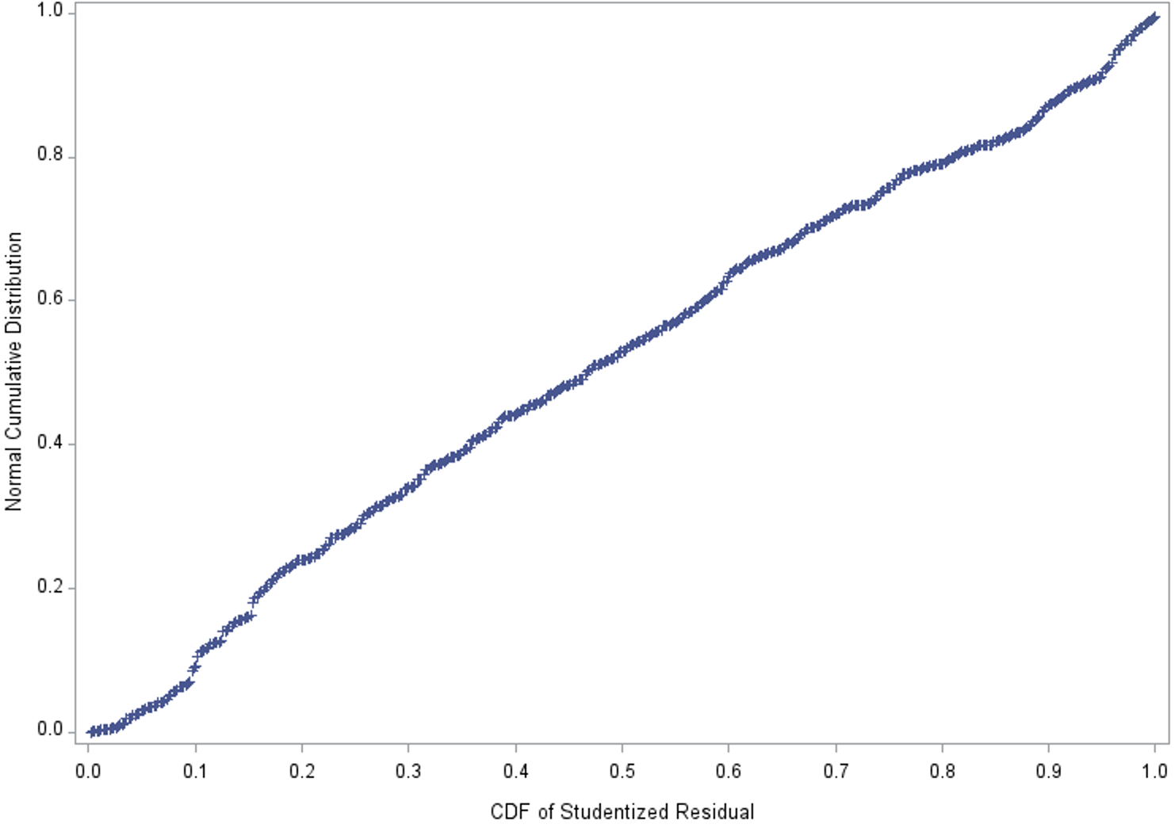
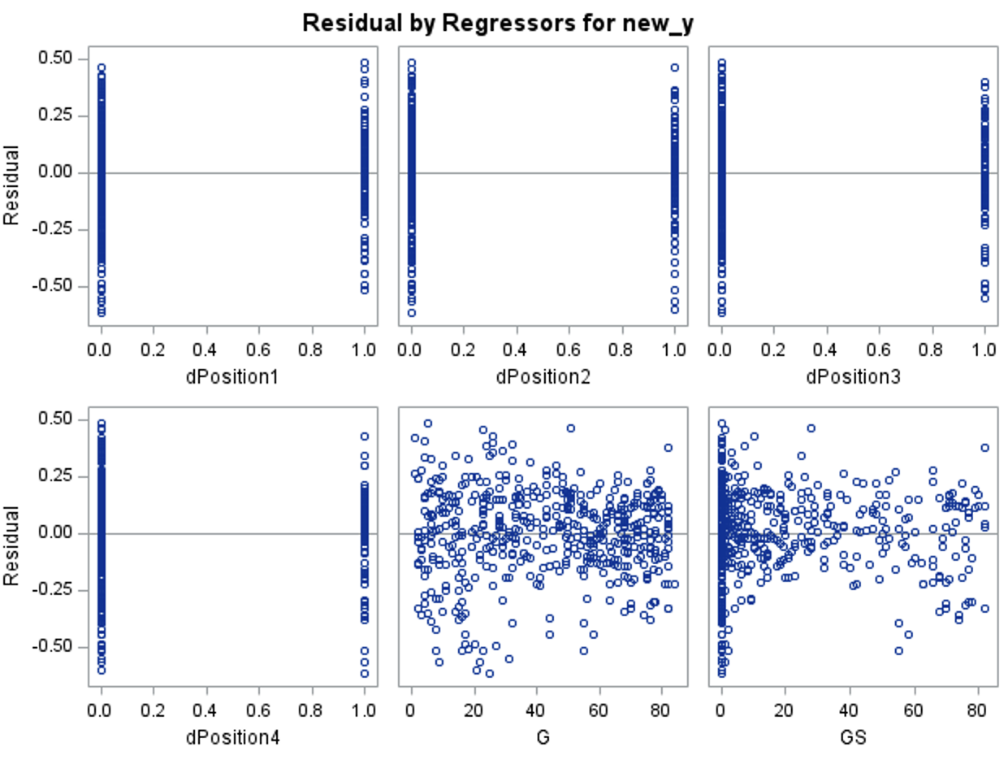
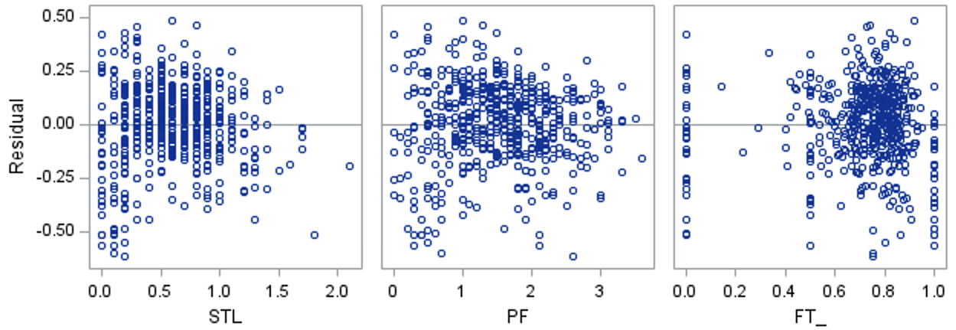
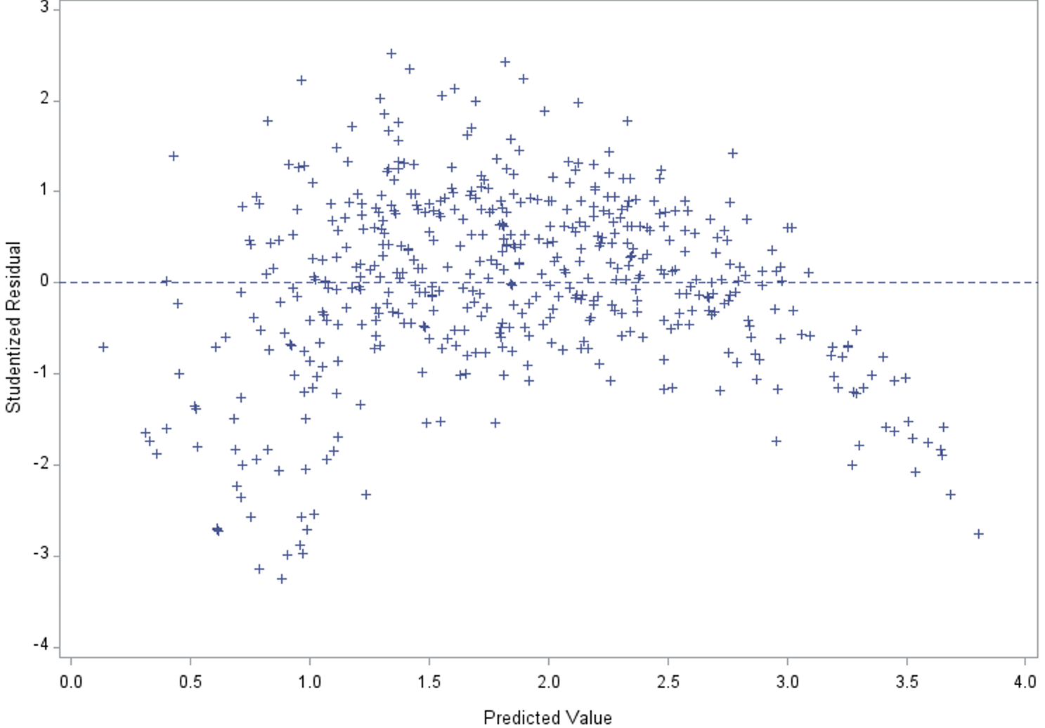
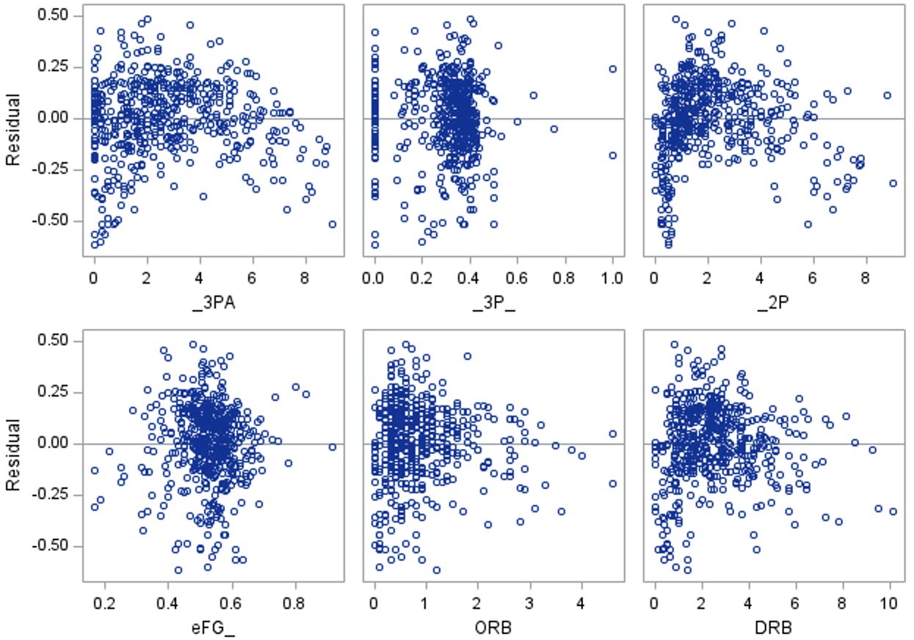

Slide 31
Capability Potential, CP
Assumptions and Diagnostics
Residuals vs x-variables
Residuals vs Predicted
Normality Plot
Outliers and Influential Points
Multicollinearity

Slide 32
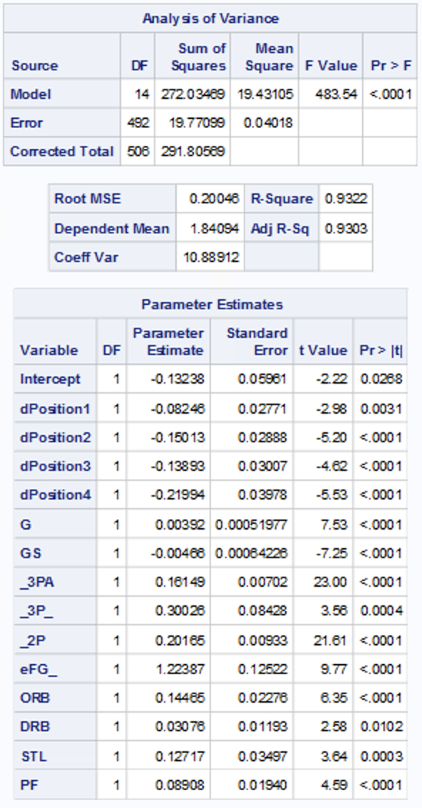
Backward
Final Equation
logPTS = -0.1324 – 0.0825 dPosition1 – 0.1501 dPosition2 – 0.1389 dPosition3 – 0.2199 dPosition4 + 0.0039 G - 0.0047 GS + 0.1615 3PA + 0.3003 3P% 0.2017 2P + 1.2239 eFG% + 0.1447 ORB + 0.0308 DRB + 0.1272 STL + 0.0891 PF

Slide 33
Backward
Interpreting the final equation:
dPosition1: logPTS will decrease 7.9189% if this goes up by one
dPosition2: logPTS will decrease 13.9378% if this goes up by one
dPosition3: logPTS will decrease 12.9685% if this goes up by one
dPosition4: logPTS will decrease 19.7401% if this goes up by one
G: logPTS will increase 0.3908% if this goes up by one
GS: logPTS will decrease 0.4688% if this goes up by one
3PA: logPTS will increase 17.5272% if this goes up by one
3P%: logPTS will increase 35.0263% if this goes up by one
2P: logPTS will increase 22.3481% if this goes up by one
eFG%: logPTS will increase 240.0424% if this goes up by one
ORB: logPTS will increase 15.5693% if this goes up by one
DRB: logPTS will increase 3.1279% if this goes up by one
STL: logPTS will increase 13.5644% if this goes up by one
PF: logPTS will increase 9.3190% if this goes up by one

Slide 34
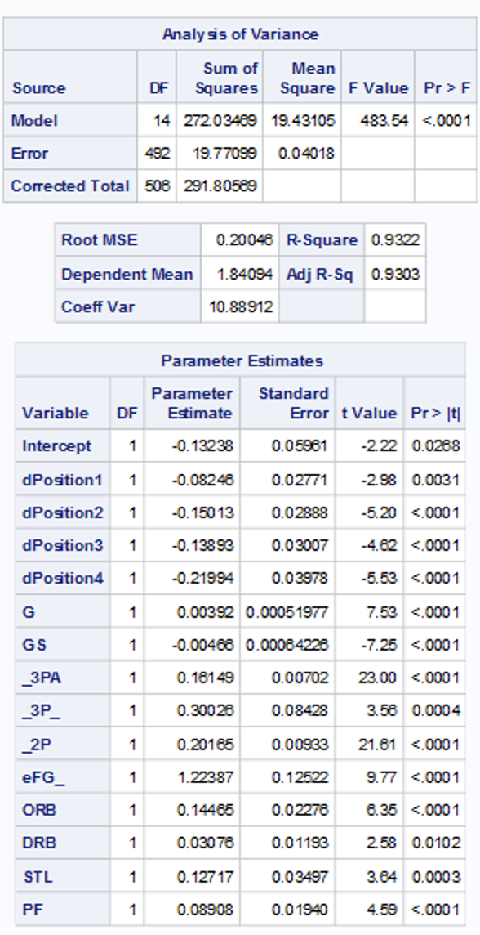
Backward
Performance
R² = 93.22%
Adj-R² = 93.03%
GOF
RMSE

Slide 35
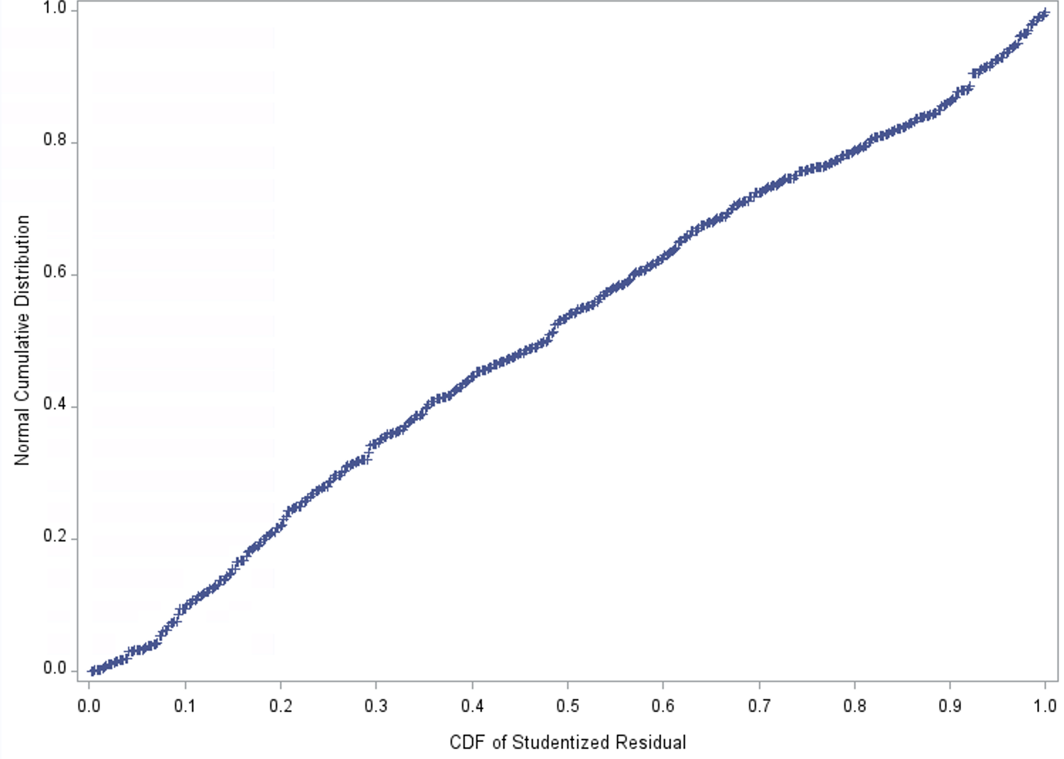
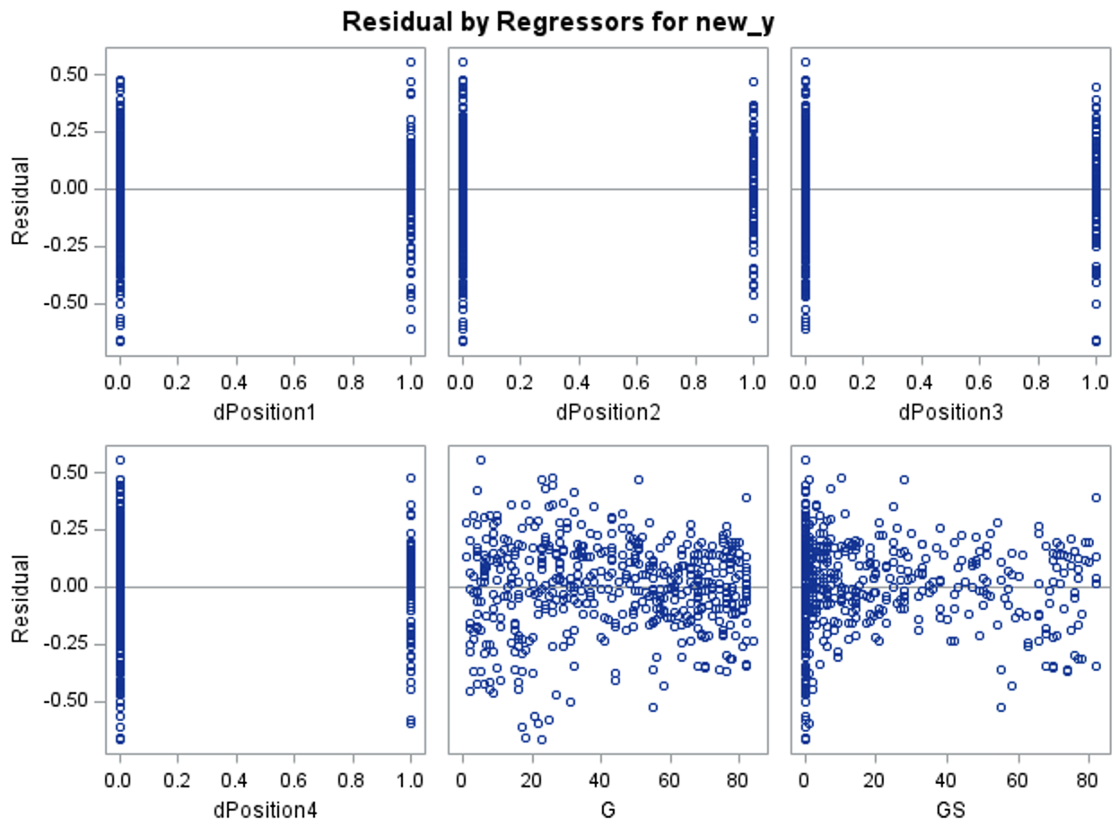




Slide 36

Model #1, CP Final-final Equation
logPTS = -0.2172 – 0.0645 dPosition1 – 0.1284 dPosition2 – 0.1053 dPosition3 – 0.1803 dPosition4 + 0.0032 G – 0.0041 GS + 0.1551 3PA + 0.2111 3P% + 0.2005 2P + 1.2037 eFG% + 0.1317 ORB + 0.0264 DRB + 0.1219 STL + 0.0882 PF + 0.2448 FT%
R² = 94.15%
Adj-R² = 93.97%
GOF
RMSE

Slide 37
Model #1, CP Final-final Equation
Interpreting the final-final equation
dPosition1: logPTS will decrease 6.2464% if this goes up by one
dPosition2: logPTS will decrease 12.0498 % if this goes up by one
dPosition3: logPTS will decrease 9.9946% if this goes up by one
dPosition4: logPTS will decrease 16.4980% if this goes up by one
G: logPTS will increase 0.3205 % if this goes up by one
GS: logPTS will decrease 0.4092% if this goes up by one
3PA: logPTS will increase 16.7775% if this goes up by one
3P%: logPTS will increase 23.5036% if this goes up by one
2P: logPTS will increase 22.2014% if this goes up by one
eFG%: logPTS will increase 233.2424% if this goes up by one
ORB: logPTS will increase 14.0766% if this goes up by one
DRB: logPTS will increase 2.6752% if this goes up by one
STL: logPTS will increase 12.9641% if this goes up by one
PF: logPTS will increase 9.2207% if this goes up by one
FT%: logPTS will increase 27.7366% if this goes up by one

Slide 38

Model #2, Backward Final-final Equation
logPTS = -0.1107 – 0.0710 dPosition1 – 0.1335 dPosition2 – 0.1157 dPosition3 – 0.1816 dPosition4 + 0.0037 G – 0.0043 GS + 0.1591 3PA + 0.2766 3P% + 0.2027 2P + 1.2483 eFG% + 0.1269 ORB + 0.0250 DRB + 0.1244 STL + 0.0936 PF
R² = 93.80%
Adj-R² = 93.62%
GOF
RMSE

Slide 39
Model #2, Backward Final-final Model
Interpreting the final-final equation
dPosition1: logPTS will decrease 6.8538% if this goes up by one
dPosition2: logPTS will decrease 12.4972% if this goes up by one
dPosition3: logPTS will decrease 10.9258% if this goes up by one
dPosition4: logPTS will decrease 16.6065% if this goes up by one
G: logPTS will increase 0.3707% if this goes up by one
GS: logPTS will decrease 0.4291% if this goes up by one
3PA: logPTS will increase 17.2455% if this goes up by one
3P%: logPTS will increase 31.8639% if this goes up by one
2P: logPTS will increase 22.4705% if this goes up by one
eFG%: logPTS will increase 248.4414% if this goes up by one
ORB: logPTS will increase 13.5303% if this goes up by one
DRB: logPTS will increase 2.5315% if this goes up by one
STL: logPTS will increase 13.2469% if this goes up by one
PF: logPTS will increase 9.8120% if this goes up by one

Slide 40


Training vs Training
R²
Adj-R²
Root MSE
GOF
Residuals

Slide 41


Test vs Test
RMSE
MAE
R²
Adj-R²
R² = 93.27
R² = 93.84
|R² Training – R² Testing| = 93.80 – 93.27 = 0.53
|R² Training – R² Testing| = 94.15 – 93.84 = 0.31

Slide 42
Model #1, Train vs Test
RMSE
R²
R² = 93.84

Slide 43
Model #2, Train vs Test
RMSE
R²
R² = 93.27

Slide 44
Train Model 1, CP Model 2, Backward
RMSE = 0.18053 RMSE = 0.18574
R² = 94.15% R² = 93.80%
Adj-R² = 93.97 Adj-R² = 93.62
Residuals = ✅ Residuals = ✅
GOF = F-Val: 516 P-Val: < 0.001 GOF = F-Val: 520 P-Val: <0.001
Testing RMSE = 0.18941 RMSE = 0.18941
MAE = 0.14690 MAE = 0.14690
R² = 93.84% R² = 93.27%
Adj-R² = 93.70 Adj-R² = 93.13
CV-R² = 0.31 CV-R² = 0.53

Slide 45
Comparisons
Train Model 1, CP Model 2, Backward
RMSE = 0.18053 RMSE = 0.18574
R² = 94.15% R² = 93.80%
Adj-R² = 93.97 Adj-R² = 93.62
Residuals = ✅ Residuals = ✅
GOF = F-Val: 516 P-Val: < 0.001 GOF = F-Val: 520 P-Val: <0.001
Testing RMSE = 0.18941 RMSE = 0.18941
MAE = 0.14690 MAE = 0.14690
R² = 93.84% R² = 93.27%
Adj-R² = 93.70 Adj-R² = 93.13
CV-R² = 0.31 CV-R² = 0.53

Slide 46

Prediction Model #1, CP
Predicted Value
Low
High

Slide 47

Prediction Model #2, Backward
Predicted Value
Low
High

Slide 48

The End

